Slide 1
STATG019 – Selected Topics in Statistics 2015 Lecture 2
The Support Vector Machine
Dr Franz J. Király

Slide 2
Course organization
In-Course-Assessment
Two take-home ICA, one on kernels, one on point processes
Each counts 50% towards your final grade
Handing out: no.1 on Feb 9, no.2 on Mar 23 (on moodle) Submission: no.1 on Mar 4, no.2 on Apr 29 (via moodle/TurnitIn)
Further details will be announced via the moodle news forum
Tutorials and/or practical sessions
Thursday, 11am - 1pm location varies
Given topic survey: next tutorial will be mainly on kernlab with R
Please install R and kernlab on your laptops (cluster rooms are full)
We do not have a room yet for tomorrow – do you know of any place?
Did you try the exercises? What do you think about them?

Slide 3

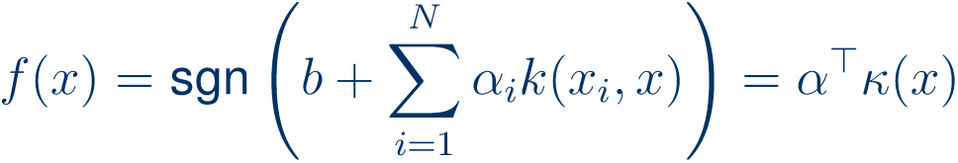


A short overview of the kernel SVM
the Support Vector Machine
Input:
Output:
separator/decision function
“Kernelized”, non-linear variant:
v
v

Slide 4
The linear Support Vector Machine
(V. Vapnik, 1993)

Slide 5







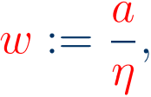
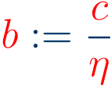
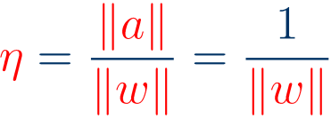
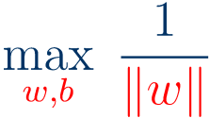


The support vector machine
Goal: linearly separate two classes of points
with maximum margin
Mathematically:
find a hyperplane
“support vectors”
separating the green and the orange points
with the largest symmetric margin
of
for all orange points
for all green points
This can be reformulated as the optimization problem
s.t.
Issue: overparamterization!
can be multiplied by common factor
Solution: make substitutions
thus
to obtain
Issue: objective function inverse of square root
s.t.
bad optimization behaviour
Solution: replace
by the equivalent

Slide 6
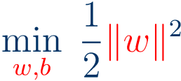
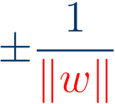





The support vector machine
Goal: linearly separate two classes of points
with maximum margin
Quadratic optimization program:
“support vectors”
s.t.
margin is
hyperplane is
“Naïve” Kernelization (Chapelle, 2006):
obtain:
where
kernel matrix
s.t.
empirical kernel vector
This is a convex optimization problem in
The following is about an alternative (“dual” SVM) which is more popular for historical reasons.

Slide 7
Lagrange duality

Slide 8


















Lagrange duality
Start with an optimization program
“primal program”
is the loss function to be minimized
s.t.
(component-wise)
Definition:
the Lagrangian for the above problem is
the Lagrange dual function is
the (Lagrange) dual program is
s.t.
Proposition:
“duality gap”
Theorem (Slater):
If the primal problem is convex, i.e.,
“strong duality holds”

Slide 9





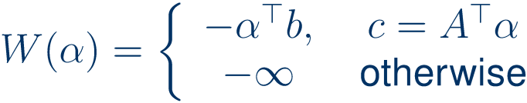

Lagrange duality
primal program
dual program
s.t.
s.t.
Theorem (Slater):
If the primal problem is convex, i.e.,
“strong duality holds”
Observation:
Example 1: linearly constrained linear program
primal program
dual program
s.t.
s.t.
dual program is in standard form

Slide 10


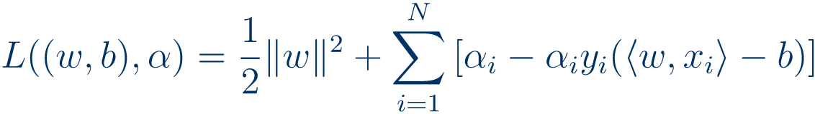
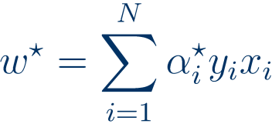
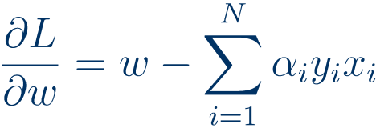
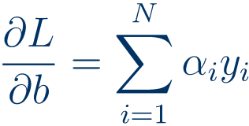
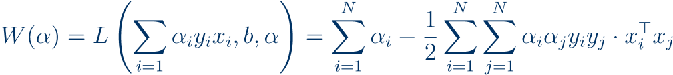


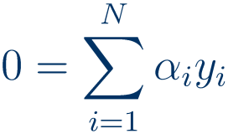

Lagrange duality
primal program
dual program
s.t.
s.t.
Example 2: the support vector machine
primal program
s.t.
note: this is a convex program
is zero of first derivatives:
due to convexity, minimizer
implies
(compare representer theorem!)
therefore
dual program
Kernelizable!
s.t.

Slide 11
The kernel Support Vector Machine

Slide 12
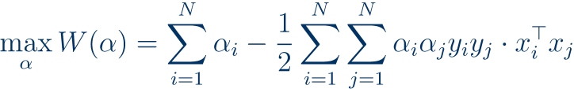
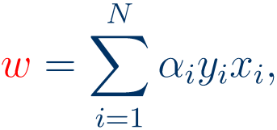
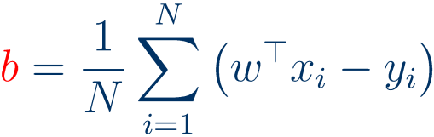

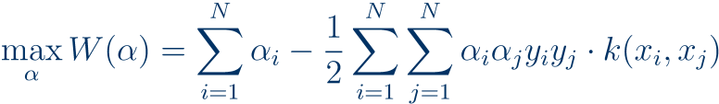
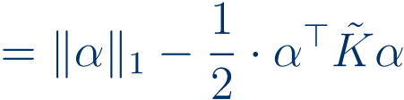

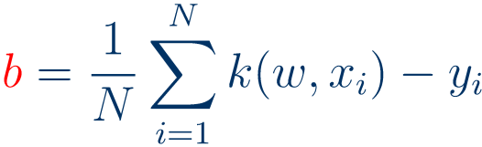


The kernel support vector machine
The linear support vector machine
Primal formulation:
“support vectors”
s.t.
Dual formulation:
s.t.
Obtain
Predicted label is
The dual Kernel SVM
s.t.
where
(this is a psd kernel matrix)
“sparse norm”
Obtain
Predict
where

Slide 13





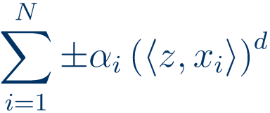

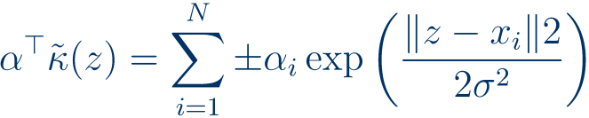

Intuition on the non-linear kernel SVM
s.t.
Obtain
Predict
Observation:
separator is manifold of form
“kernel support vectors”
kernel feature map
this margin is maximized
v
v
For polynomial kernel:
“sparse Waring form”
For Gaussian kernel:
due to feature space infinite:
(though many entries will be small)

Slide 14
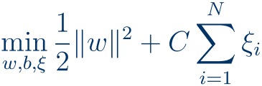


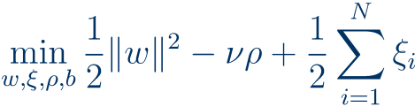



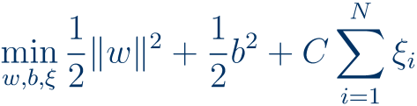
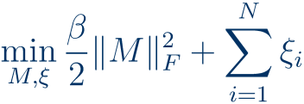
A dictionary of kernel Support Vector Classifiers
name
how it differs from the vanilla-SVM
pros/cons
type in R kernlab-ksvm
(hard-margin)
The original formulation (previous slide)
Very outlier sensitive, solution may not exist. Don’t use.
C-svc set C=0
SVC
s.t.
Working horse of support vector classification.
soft-margin SVC
or C-SVC
C-svc
(Cortes, Vapnik)
data points can lie outside the margin
P: easy, sparse solution
C: somewhat outlier sensitive
nu-SVC
support vector classification
(Schölkopf et al)
which emphasizes number of outliers above severity
s.t.
nu-svc
data points can lie outside the margin
P: good for severe outliers
fraction of violations of margin
C: tends to overfit more
is hard-bounded above by
bound-constraint SVC
otherwise same as C-SVC
minor variant of C-SVC
P: can be worth trying
C-bsvc
(Mangasarian et al)
equivalent to homogenous & no intercept
C: sometimes it isn’t
Weston/Watkins: sum of C-SVC
better than naïve one-vs-one or one-vs-all multiclassifiers
multi-class SVC
kbb-svc
W/W-risk is closer to C-SVC
spoc-svc
Crammer/Singer:
C/S-risk is closer to nu-SVC

Slide 15
Regression and Outlier Detection with the SVM

Slide 16


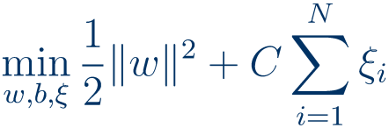



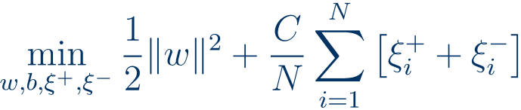





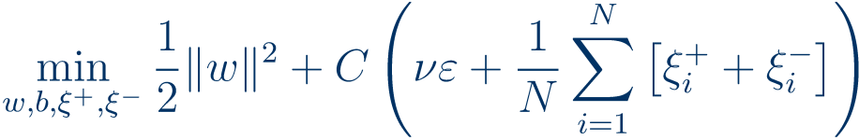

Kernel support vector regression
Classification:
learn a classifier
Regression:
learn a regressor
Idea:
instead of mis-classification, penalize
with a margin
C-SVC:
s.t.
eps-SVR:
parameters
s.t.
nu-SVR = eps-SVR + nu-SVC
parameters
bound-constraint SVR = eps-SVR + b²
s.t.
kernlab-ksvm:
(pros/cons analogous to SVCs)
eps-svr, nu-svr, eps-bsvr

Slide 17
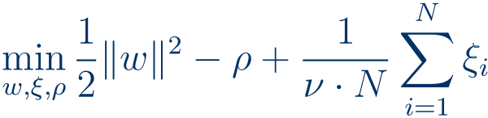



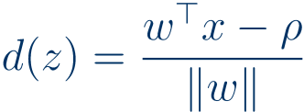

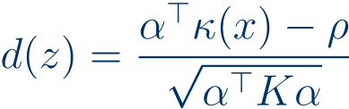
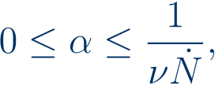

Novelty detection with the one-class SVM
Classification:
learn a classifier
Novelty detection:
so far are “normal”
Learn a classifier that is able to identify “abnormal” points
Idea:
“normal” points should be separated from origin by boundary (with slack)
C-SVC:
s.t.
1-SVC:
parameter
s.t.
upper bound on training points past the margin
Outlier score = distance to “normal” side
1-SVC after kernelization:
and
where
s.t.
kernlab-ksvm: one-svc
improved variants exist (but not in R)

Slide 18
Using the SVM in kernlab

Slide 19
Support vector learning in kernlab
ksvm encapsulates all methods of support vector learning discussed today
Prior to use, kernlab has to be loaded with library(kernlab)
usage for training:
svmmodel <- ksvm(vartopredict~.,data=traindata,…)
trains a SVM, stored in the output variable svmmodel of type ksvm
important parameters for ksvm:
type
determines the kind of learning machine, e.g. "C-svc"
kernel
determines the kernel used, e.g. "rbf-dot"
kpar
a list of kernel parameters, e.g. list(sigma=1)
C,nu,epsilon
regularization parameters for the various methods
output contains model as alpha,b,alphaindex:
usage for prediction:
predicted <- predict(svmmodel, testdata)
yields a vector predicted of predictions for testdata
Documentation: http://cran.r-project.org/web/packages/kernlab/kernlab.pdf
Type help(ksvm) or example(ksvm) for more details and examples

Slide 20

Methods for model selection
Major issue:
In kernels and in the support vector learning methods, there are regularisation parameters to choose, such as
etc.
“universal” solution:
Cross-validation
learn
(param-specific solutions exist, also topic of ongoing research)
learn
for ksvm:
error estimation by k-fold cross-validation by setting param. cross = k
estimated cross-validation error is returned as cross
cross-validation for class probabilities with parameter prob.model = T
cross-validation for parameters: manually, or by wrapper (e.g. cvTools, caret)

Slide 21
Outlook
Lecture 1: Introduction to kernels
Main concepts and theoretical results, learning guarantees
Kernel PCA and kernel ridge regression
Some notes on R and kernlab
Lecture 2: the kernel support vector machine
The linear support vector machine, duality
Hard- and soft-margin two-class SVM
The one-class SVM
Support vector regression
Lecture 3: Gaussian processes and kernel learning
Potential further lecture topics:
Algorithms: kernel discriminants, kernel k-means, kernel quantile regression kernel CCA, kernel MMD, kernel relevance vector machine
Large-scale learning with kernels, subset methods and Nyström-approximation
Combinatorial kernels: string kernels, graph kernels
Invariance kernels
Vapnik-Chervonenkis learning theory
Outlier detection, novelty detection
On-line kernel learning

Slide 22
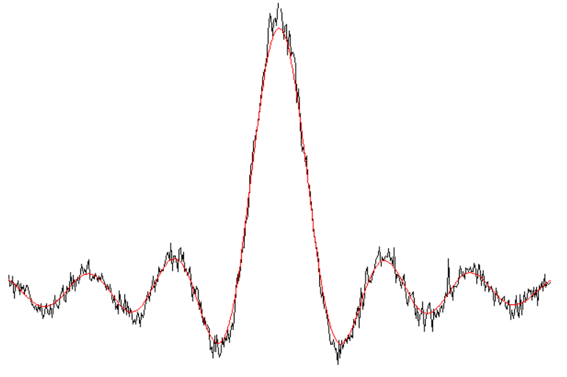
Next week:
Gaussian Processes

